Slide 1
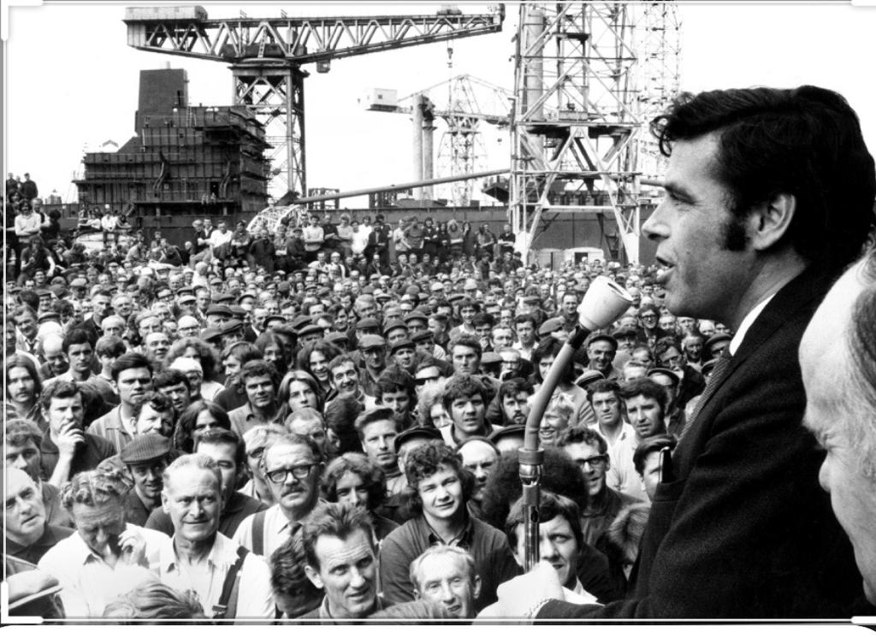
Jimmy Reid Memorial Lecture
Rector Aamer Anwar
Lawyer, Activist, Human Rights Campaigner

Slide 2
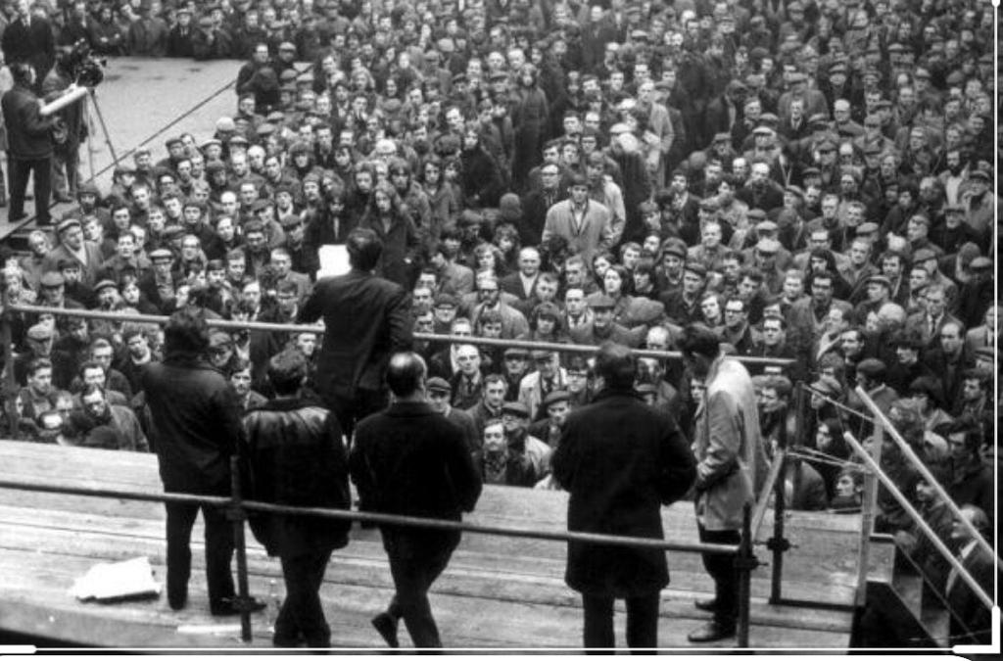

Slide 3
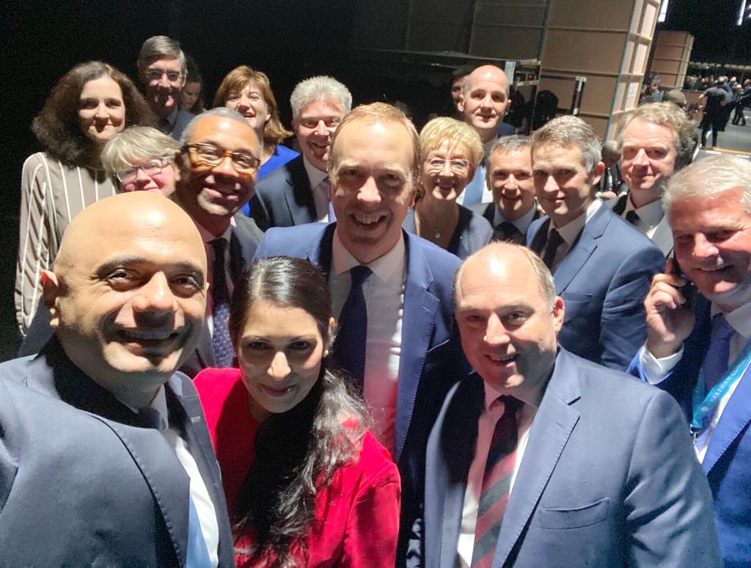
Notes:
Priti Patel

Slide 4
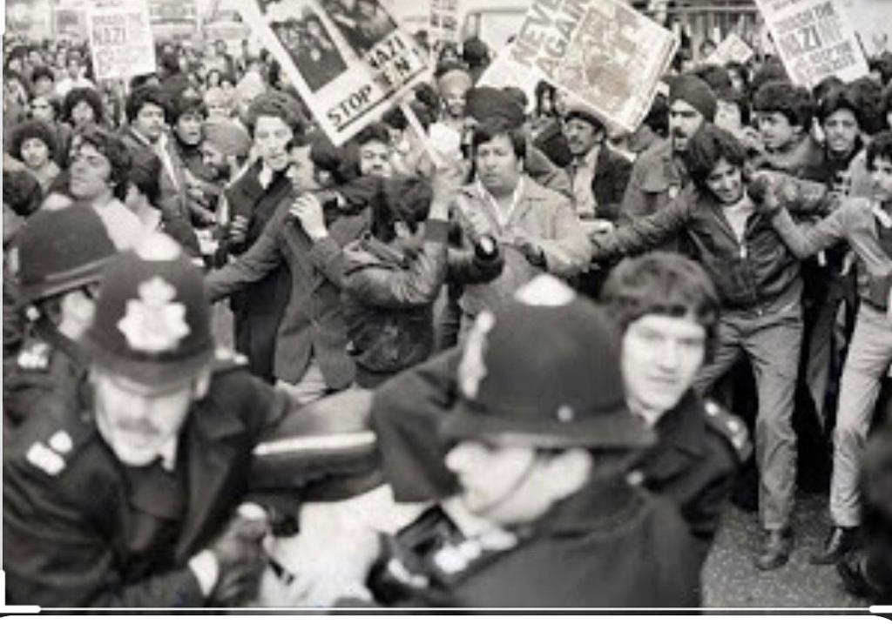
Notes:
Southhall _Black history month

Slide 5
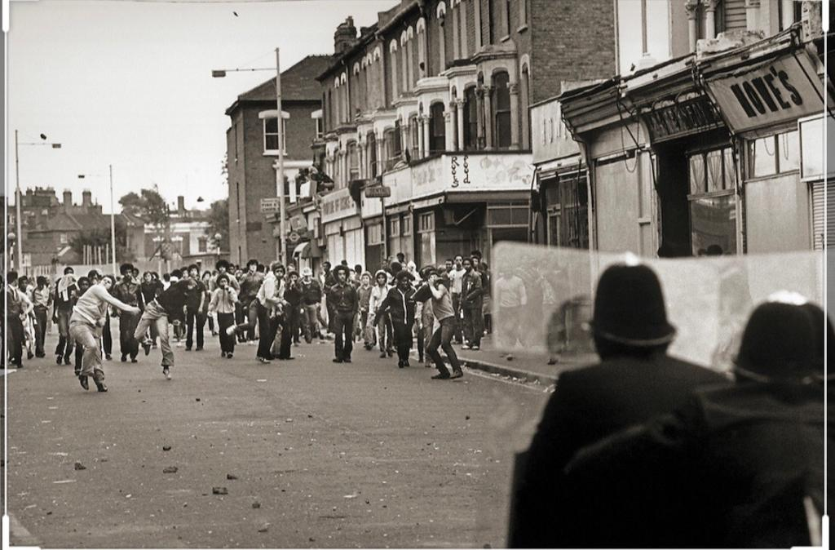

Slide 7
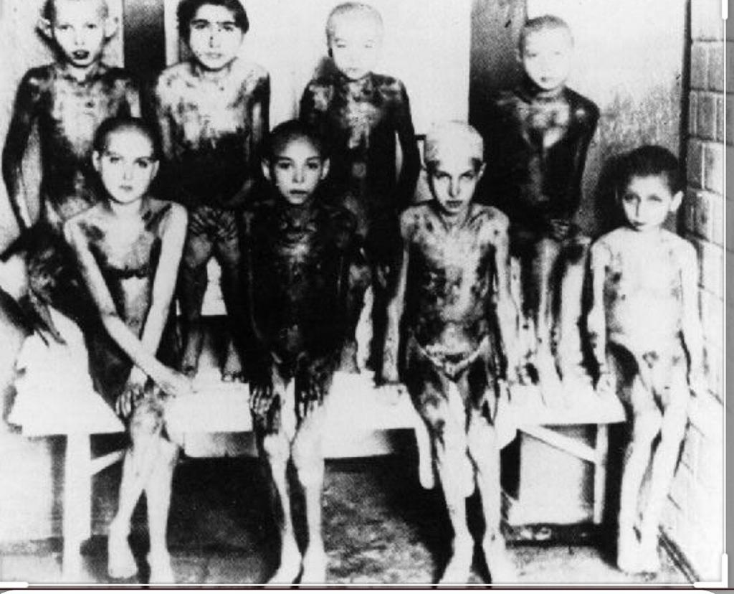
Notes:
holocaust

Slide 9


Slide 10



Slide 11
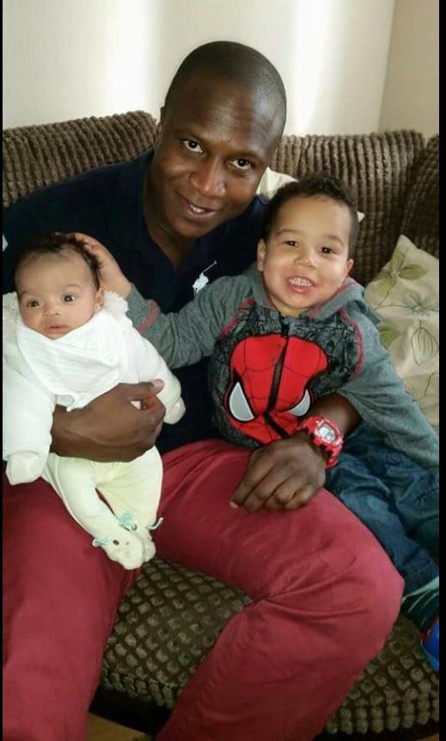
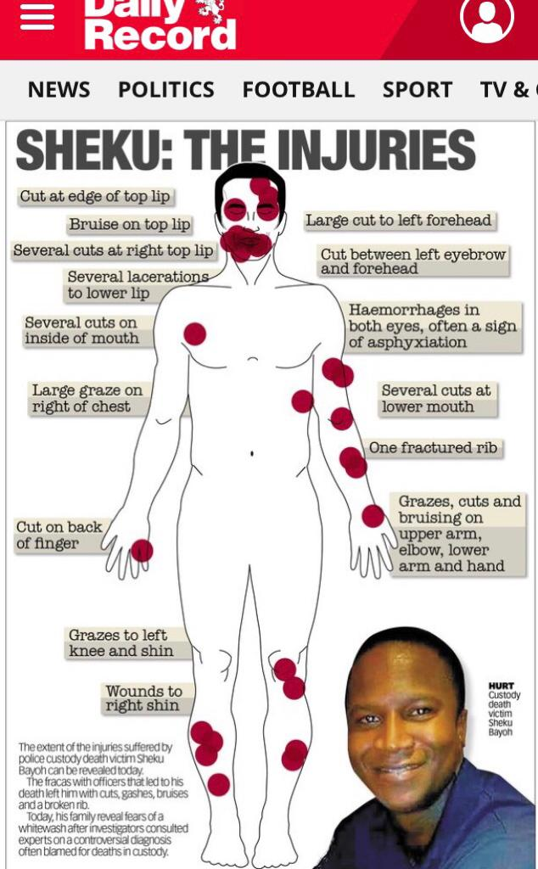

Slide 12
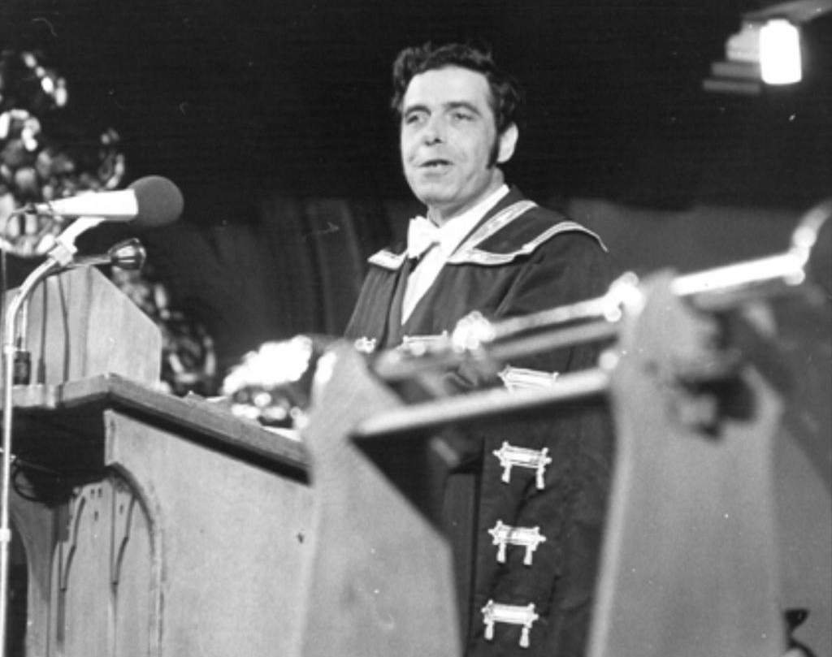
Thank You
JIMMY REiD MEMORIAL LECTURE
10 OCTOBER 2019
Aamer Anwar
“Whilst the Dead cannot cry out for Justice, it is the duty of the living to do so for them”

